Slide 1
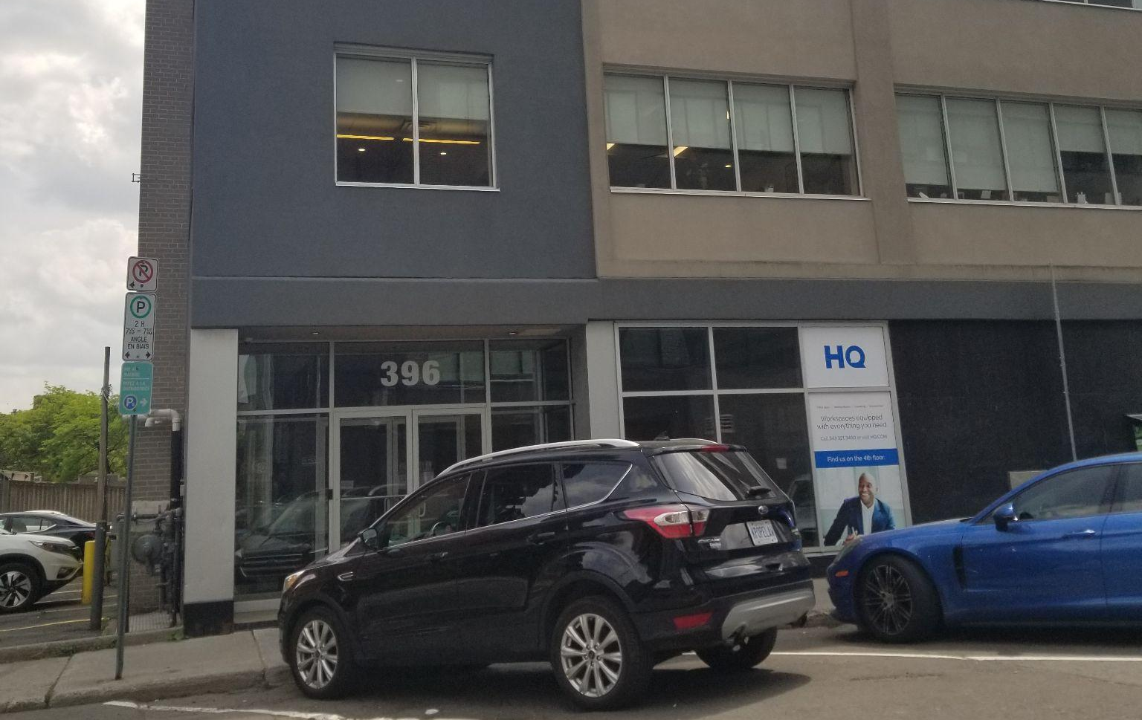




SUBLEASE
OFFICE SPACE
396 Cooper St. Suite #202, Ottawa, ON, K2P 2H7
BUILDING FEATURES
SUBLEASE DETAILS
AREA/LOCATION | Ottawa Central Business District 4102 - City Centre
NET RENTAL RATE | $17 / SF
RECOVERABLE COSTS | $15.86/ SF
OFFICE SPACE | ~ 2,117 SF
SUBLEASE TERM | Expires December 2026
ZONING CODE | TM H (19)
AVAILABILITY | Immediate
2,117 sq.ft. Professional Office Space available
Reception + 2 Standard Offices + 1 Executive Office + Lunchroom and a large, open-concept workspace
Open Concept Collaboration Workspace
3 Standard Offices + 1 Executive Office
Private Male/Female Bathrooms (code access entry) on each floor
2 Parking spots at $175/ea (additional available)
New Elevator (2020), Windows (2012) & Upgrades to HVAC system
Rare Short Term Lease Option (1 year +)
Favorable Renewal Terms Obtainable
CAPWORTH COMMERCIAL REALTY
BROKERAGE CORPORATION
613.879.6388
613.663.2549 EXT. 2
www.capworthreatly.com

Slide 2
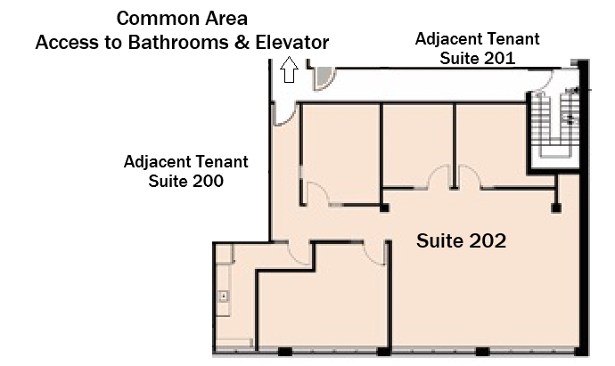

Unit Footage Net + Addt’nl Monthly Rent
Suite 202 2,117 SF $17/SF + $15.86 Approx. $5,797.05/month + HST
FLOORPLAN
Wei-L ING Tan
Commercial REALTOR® & Sales Representative
Capworth Commercial Realty Brokerage Corp.
Direct Mobile #: (613) 879-6388 [TRY-ME-88]
Office Tel#: (613) 663-2549 extension 2
Email: ling@capworthrealty.com
Office: Suite 509, 1390 Prince of Wales Dr.
Headquarters / Main Office:
1390 Prince of Wales Drive,
Suite 106, Ottawa, ON, K2C 3N6
ADDITIONAL RENT INCLUDES:
General Maintenance and Repair
Building Insurance
Property Landscaping
Real Estate Taxes
Snow Removal
Water & Sewer services
Management & Administration
Heat & Hydro utilities included
Recoverable cost are estimated at $15.86 per sq. ft. for the year ending on December 31, 2025
All information, content, and materials provided are for general informational purposes only and are subject to change. No responsibility or liability whatsoever can be accepted by CAPWORTH for any loss or damage resulting from any use of, reliance on or reference to the contents of this document, including hypertext links to external sources. In addition, as a general communication, this material does not necessarily represent the view of CAPWORTH in relation to particular properties or projects, and is not intended to constitute legal advice. This communication is not intended to cause or induce breach of any agency agreement. Reproduction or distribution of this communication in whole or in part is not allowed without prior written approval of CAPWORTH. This material may not contain the most up-to-date information.
© Rights Reserved by Capworth Commercial Realty Brokerage Corporation 2025.

